Slide 1
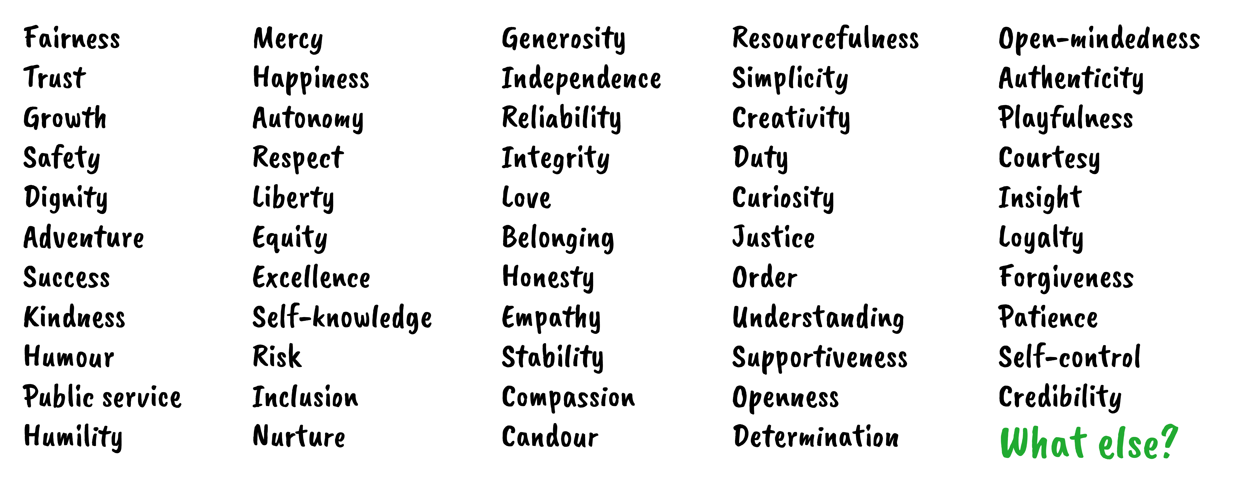
Values

Slide 2
My values compass:

Slide 3
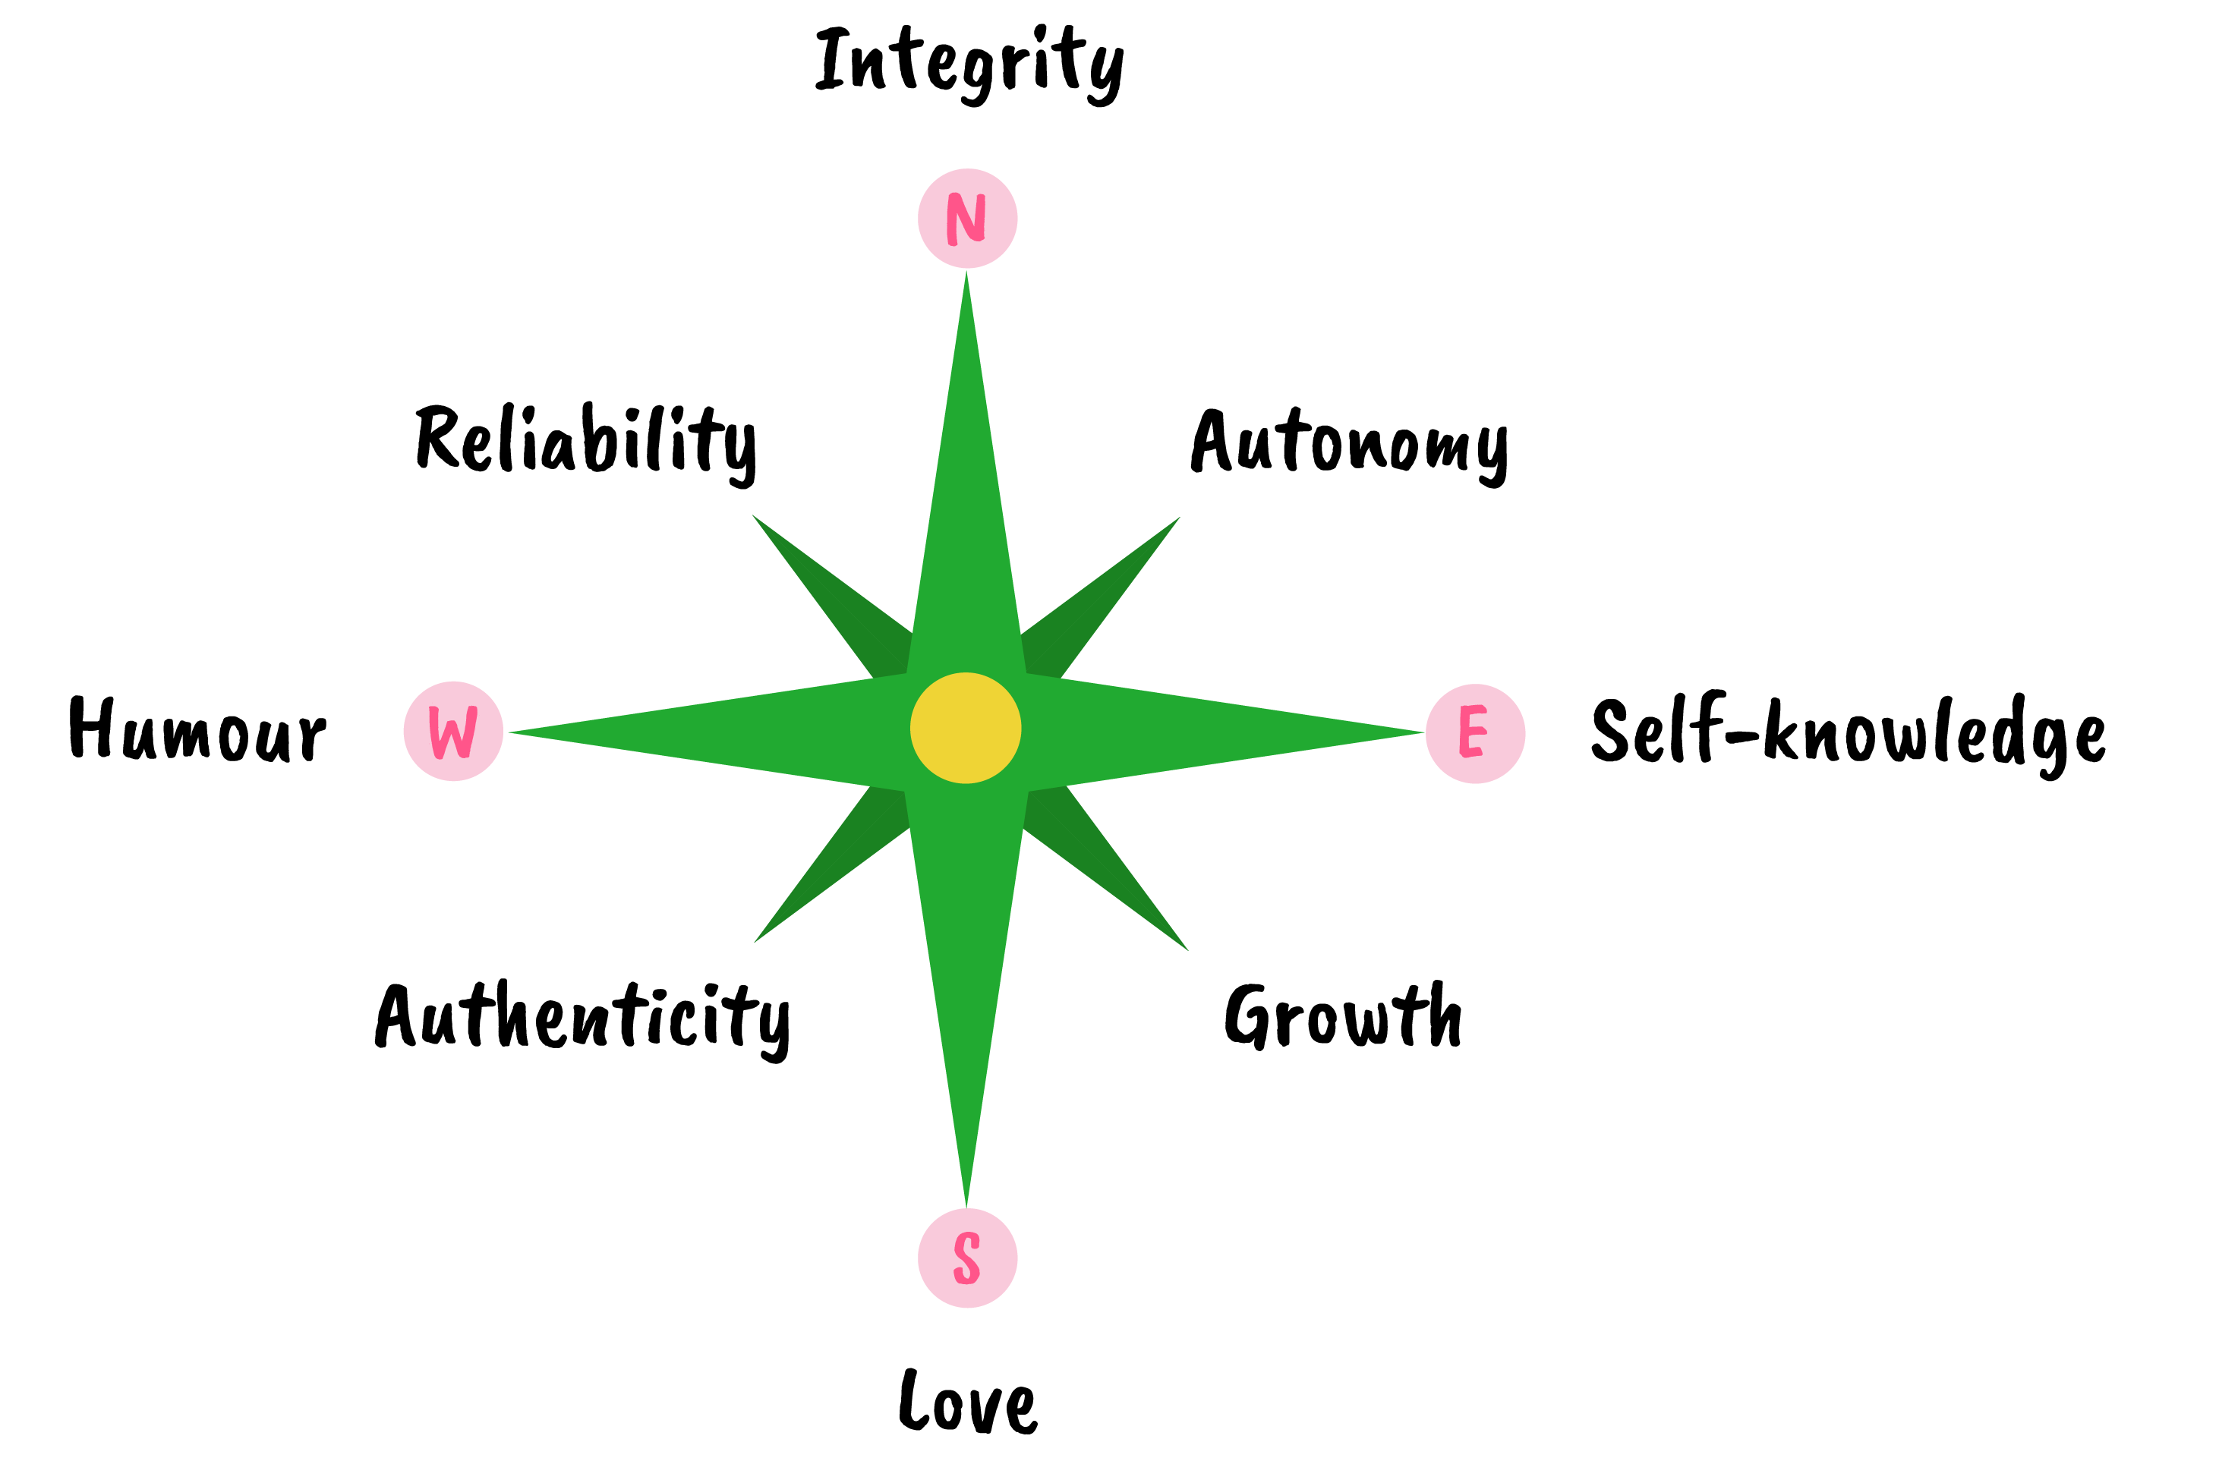
My values compass: example

Slide 4
Values Compass: Key Questions
Why are these so important to you?
How comfortably do your values ‘sit’ together?
How does it feel when you’re able to fulfil your values?
How does it affect you when your values are challenged?

